Slide 1
Unit1-partIII: access XML using JAXB
Java Architecture for XML Binding

Slide 2
JAXB
It’s the most powerful and modern way to access XML files.
JAXB converts the content of an XML file into an structure of classes in Java language. These new classes will be easily used to unmarshall(create objects reading XML files) and marshall(create XML files from objects) in running time.
To create this classes, we need to have the XML file and the XSD file (schema). The XML file needs the line xsi:noNamespaceSchemaLocation=“Books.xsd”
JAXB creates the classes related to the XML file in design time (not in running time) automatically.
After that, you can use those classes for your code

Slide 3
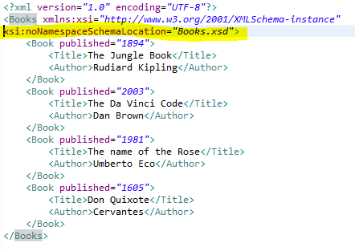
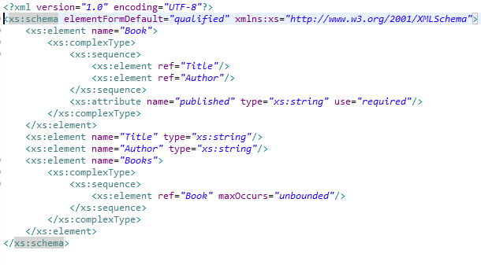
BOOKS.XML & BOOKS.XSD

Slide 4
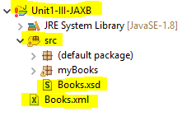
PROCESS TO USE JAXB
Locate the XML file in the source project folder
Locate the XSD file in the src folder
Import the jaxb library to your project(see practice 5) using jaxb.ri-2-2-11.zip

Slide 5
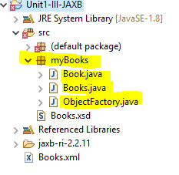
Generate automatically the classes Book.java, Books.java and ObjectFactory.java
Comment: we will need to understand the java classes List and ArrayList.

Slide 6
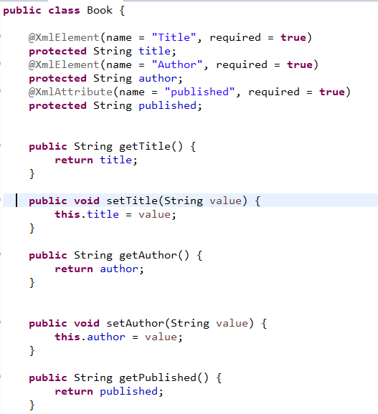

Slide 7
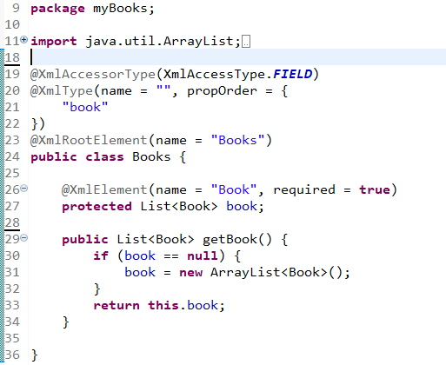

Slide 8
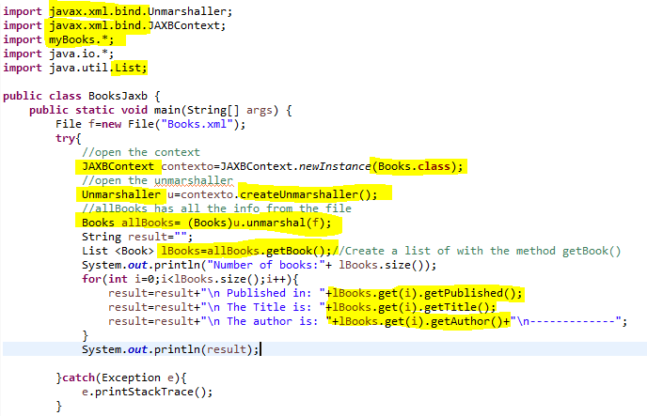
Use the created classes to access the XML file

Slide 9
Practice 6: access xml using jaxb
For this practice, we need to use the classes List and ArrayList.
List, ArrayList: see hiperlink explaining it
List and ArrayList are Java classes similar to arrays, with the difference that they don’t need a predetermined size.
The way to declare a List or an Array list is:
List<Tipe_of_object> nameOfTheList
Example:
List<Person> lper=new ArrayList<Person>();
(lper is the variable with the list of objects “Person”)

Slide 10
ArrayList Methods
size() | Devuelve el número de elementos (int)
add(X) | Añade el objeto X al final. Devuelve true.
add(posición, X) | Inserta el objeto X en la posición indicada.
get(posicion) | Devuelve el elemento que está en la posición indicada.
remove(posicion) | Elimina el elemento que se encuentra en la posición indicada. Devuelve el elemento eliminado.
remove(X) | Elimina la primera ocurrencia del objeto X. Devuelve true si el elemento está en la lista.
clear() | Elimina todos los elementos.
set(posición, X) | Sustituye el elemento que se encuentra en la posición indicada por el objeto X. Devuelve el elemento sustituido.
contains(X) | Comprueba si la colección contiene al objeto X. Devuelve true o false.
indexOf(X) | Devuelve la posición del objeto X. Si no existe devuelve -1

Slide 11
Practice 6
We will also use the classes:
JAXBContext contexto;
Unmarshaller u;
Marshaller m;
(see word document for more details)

